Slide 1
CNN-based Food Image Recognition And Nutrient Analyzer For Diabetic Patients

Slide 2
Introduction
Background
Diabetes management demands precise dietary monitoring.
CNNs offer real-time, automated food recognition and nutrient estimation.
Objective
Survey state of the CNN-based food image recognition systems.
Focus on nutrient estimation relevant to diabetic dietary needs.
Project Overview

Slide 3
Literature Overview
FoodTracker:A Real-Time Food Detection Mobile Application
It is trained on UECFood100 and UECFood256 datasets . As for the nutrition “nutritionix API” is used. It uses MobileNet
and YOLOv2 . The former is ideal for mobiles and the latter helps with identification via real time object detection.
FoodAI: Food Image Recognition via Deep Learning for Smart Food Logging
FoodAI-756 dataset is used to train here where the food is categorised into 756 classes. The detected image estimates
the item from one of the 756 classes.Nutrition is integrated via another application. ResNet,ResNeXt and SENet is used
An Artificial Intelligence-Based System to Assess Nutrient Intake for Hospitalised Patients
NIAD dataset with RGB-D image pairs are used to cover nearly 1000 items. It uses customized nutrient
database.MTCNet,learning classifiers,3D surface reconstruction algorithms are used.

Slide 4
A Comprehensive Survey of Image-Based Food Recognition and Volume Estimation Methods for Dietary Assessment
It uses various databases like Food 101,NIAD etc.. and as for nutrition it uses nutionix,USDA food data control etc… . Inception networks,ResNet,mobilenets,YOLO,densenets are used here.Here it recognises the input based on standard portion size and evaluates the nutrition intake.
Insights
ResNet(used for transfer learning),densenet(for classification of classes),Inception networks(Segregate complex images) can be used.
Suitability for the patients are classified based on carbohydrates,glycemic index and total calories.

Slide 5
Suggested Models
Model 1
Input: (224x224x3) ↓ Conv2D(32) + ReLU + BatchNorm ↓ MaxPooling + Dropout(0.25) ↓ Conv2D(64) + ReLU + BatchNorm ↓ MaxPooling + Dropout(0.25) ↓ Conv2D(128) + ReLU + BatchNorm ↓ MaxPooling + Dropout(0.25) ↓ Conv2D(256) + ReLU + BatchNorm ↓ MaxPooling + Dropout(0.25) ↓ Flatten → Dense(512) + ReLU + Dropout(0.5) ↓ Dense(101, Softmax)

Slide 6
Model 2
Input: 224x224x3 ↓ EfficientNetB3 (Pretrained) ↓ GlobalAveragePooling2D ↓ Dense(256, ReLU) ↓ Dropout(0.5) ↓ Dense(101, Softmax)

Slide 7
Model 1
Learns hierarchical visual features: edges, shapes, textures
Includes dropout and batch normalization to reduce overfitting
Moderate depth, suitable for Colab training
25 layers
Model 2
Uses EfficientNetB3 pretrained on ImageNet
Ideal for mobile-friendly, high-accuracy food classification
Fine-tuned only top layers, speeding up training
More generalizable on real-world food images
Around 390 layers (as efficientnet has 384 layers)

Slide 8
Overview
User uploads image
↓
Model (MobileNet) predicts: “Pizza”
↓
GL_food101: "Pizza"
↓
Receive: 27.86g carbs, 100g serving
↓
Get GI,GL = 60,16.716 (from reference)
↓
Label: Moderate
↓
Display: "Pizza – Moderate for diabetics"

Slide 9
Data Collection
Data collection was performed via the Nutrients.ipynb notebook.
All nutritional information is standardized per 100g serving.
Nutrient data such as carbohydrates, proteins, fats, and calories is retrieved from the USDA database.
Glycemic Index (GI) values are sourced from the University of Sydney and FoodStruct.
Any missing information is supplemented using additional resources including the Harvard Health GI Table, Glycemic-Index.net, FatSecret, NutritionValue.org, CalorieKing, and the Fitia App.

Slide 10
For commonly consumed food items without specific variations (e.g., cupcakes), average nutritional values are calculated across the entire category. For dishes like chicken curry, standardized data typically based on common preparation styles is used.
Glycemic Load (GL) is calculated based on both GI and carbohydrate content: foods with GL < 10 are classified as safe, those with GL between 10 and 20 as moderate, and values above 20 are considered high and preferably avoided.
The final consolidated dataset is stored in GL_food101.xlsx, which is directly used by the model. This file matches the predicted food class, categorizes it based on GL, and displays detailed information for the uploaded food image.
The file GI_Carbs_DataSources.xlsx contains a record of all referenced data sources

Slide 11
Model
1.Food-101 Dataset
2. Create Subset
• 101 classes
• 500 images/class
• Split: 75% train / 25% test
3. Data Generators
• Rescale images (0-255 → 0-1)
• Resize to 160x160
• Categorical labels

Slide 12
4. Build Model
• Load MobileNet (pretrained on ImageNet)
• Freeze all layers (no training)
• Add custom classifier:
- GlobalAvgPooling
- Dense
- Dropout
- Dense
5.Train Top Layers
• Train only the new layers
• Save model every 5 epoch

Slide 13
6. Fine-Tune
• Unfreeze last 30 layers
• Train again with smaller learning rate
7. Evaluate & Plot
• Show training vs. validation accuracy/loss
• Save final model
• Print final accuracy

Slide 14
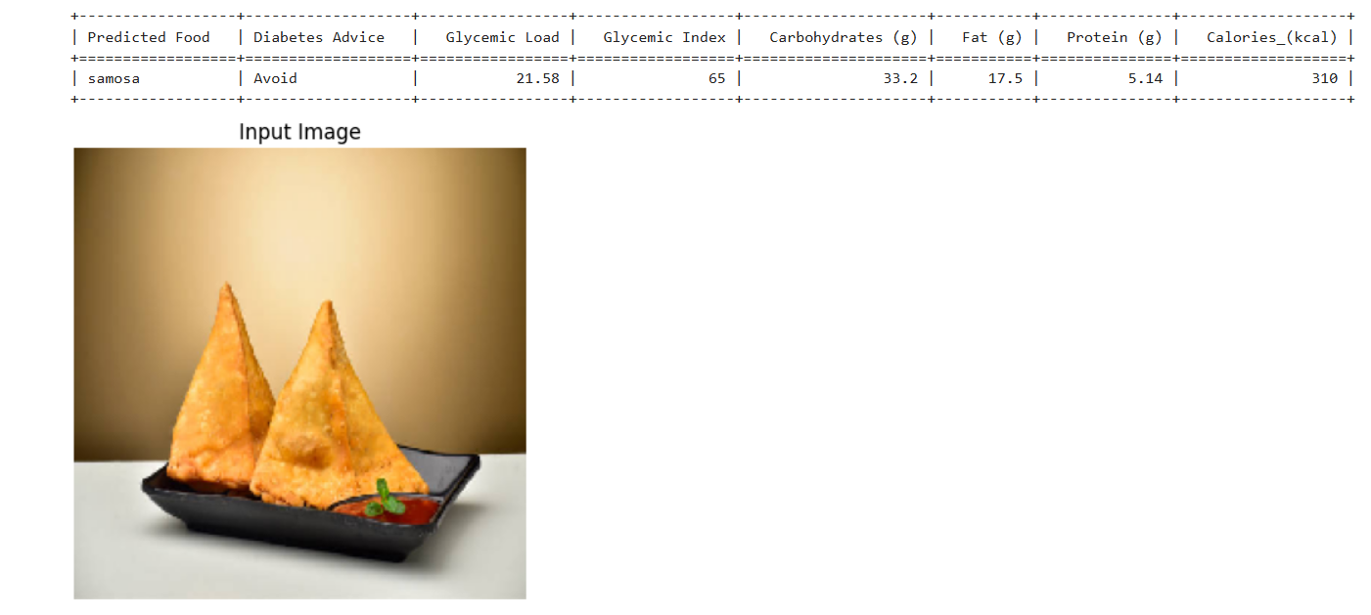
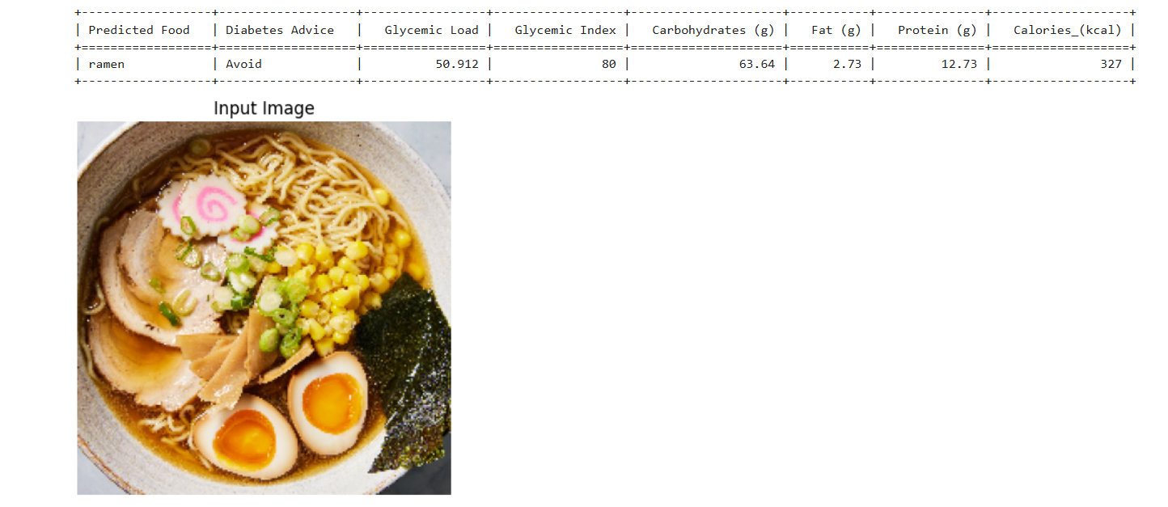
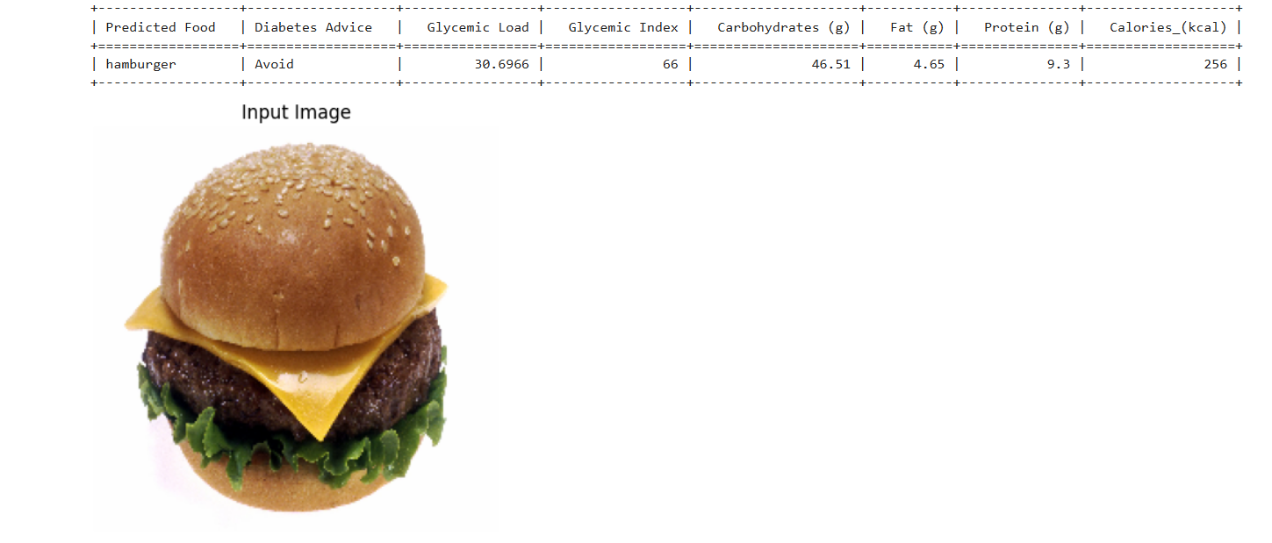
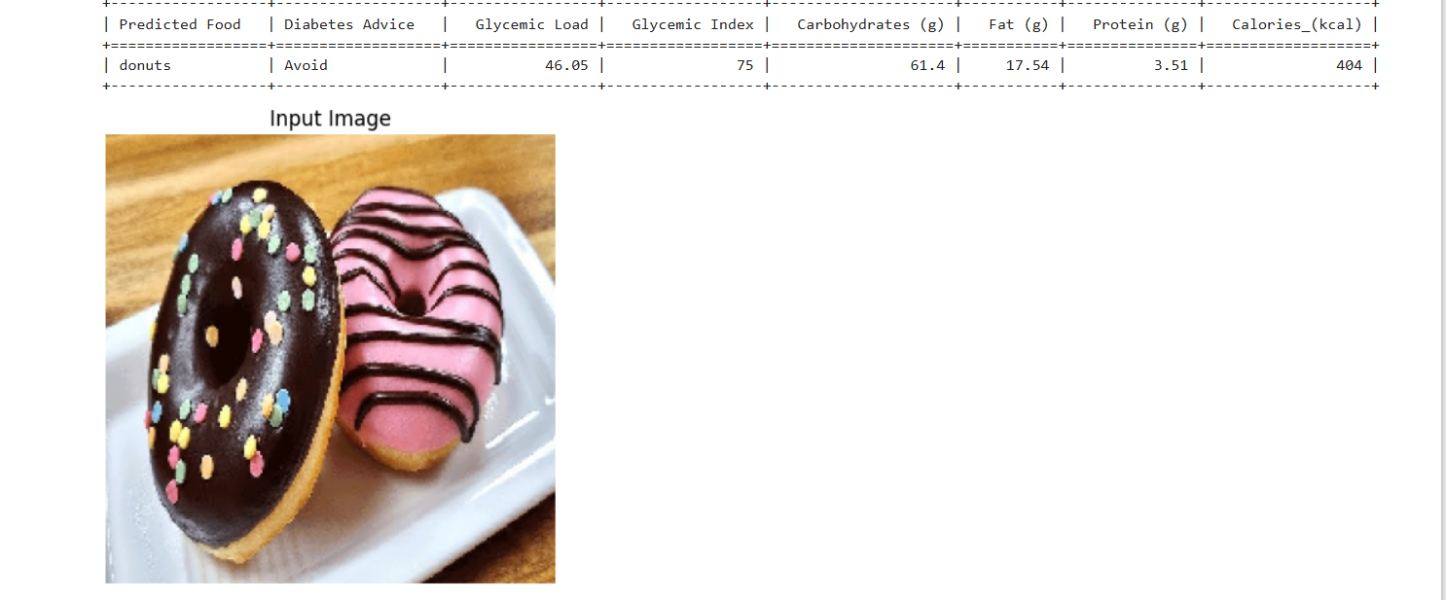
Output

Slide 15
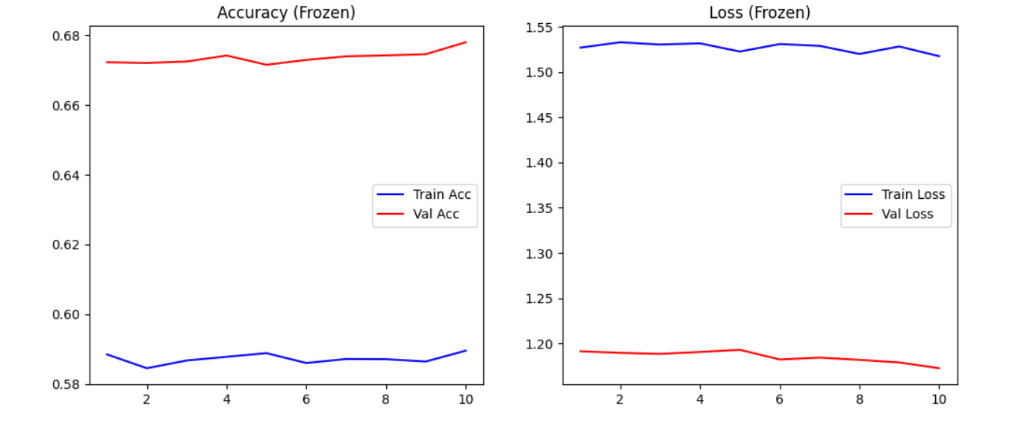
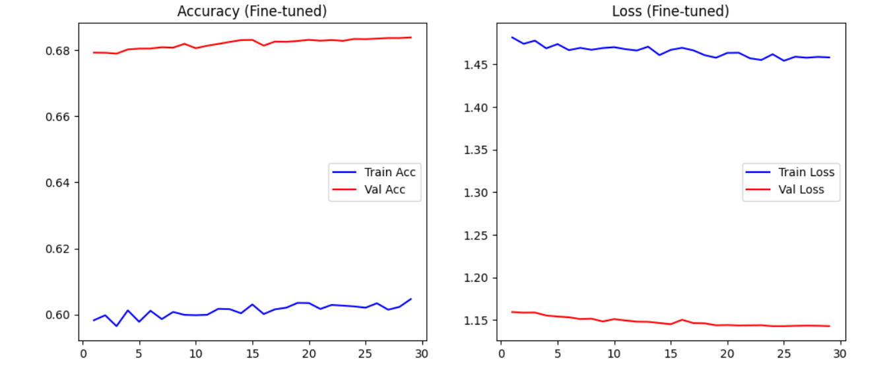
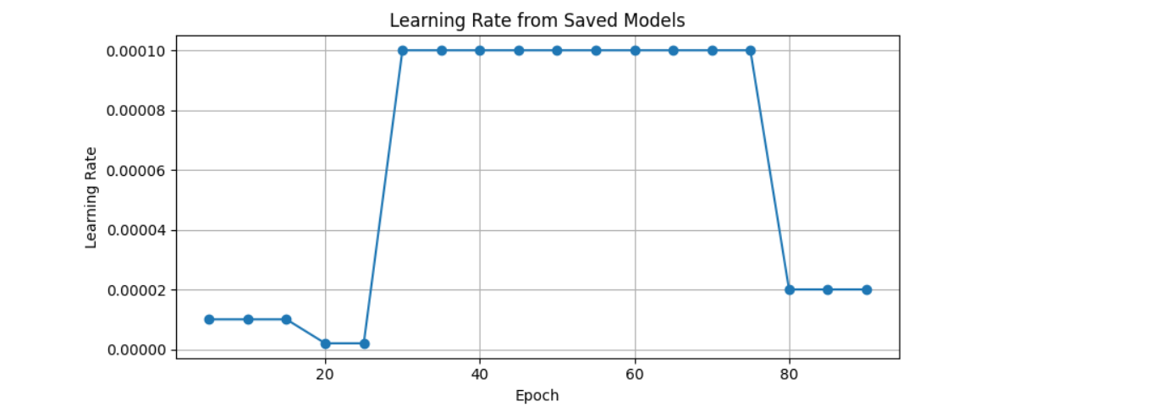
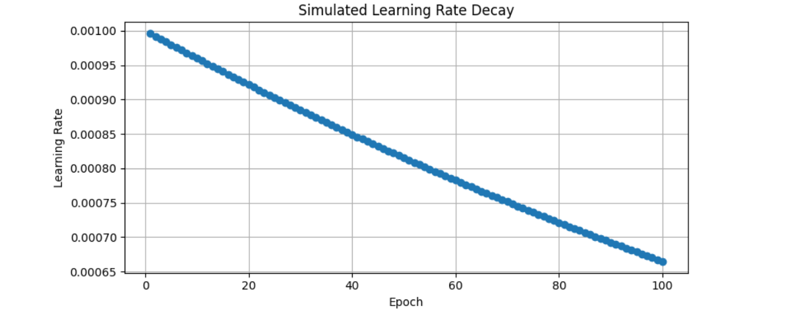
Plots

Slide 16
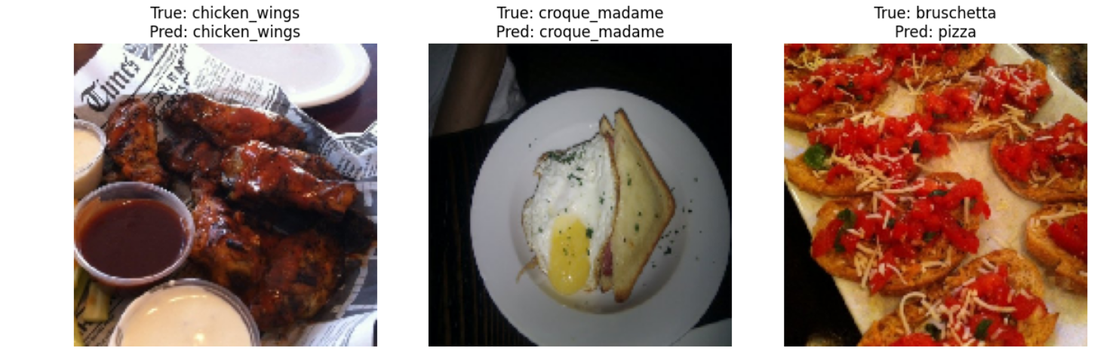
CHALLENGES
Data collection
Training the model as it has more classes to train.
The misclassification of similar looking dishes.

Slide 17
References
Sun, J., Radecka, K., & Zilic, Z. (2019). FoodTracker: A Real-time Food Detection Mobile Application by Deep Convolutional Neural Networks. arXiv. https://doi.org/10.48550/arXiv.1909.05994
Lu, Y., Stathopoulou, T., Vasiloglou, M. F., Christodoulidis, S., Stanga, Z., & Mougiakakou, S. (2020). An artificial intelligence-based system to assess nutrient intake for hospitalised patients. IEEE Transactions on Industrial Informatics, 16(11), 7474–7483. https://doi.org/10.1109/TII.2020.2987444
Tahir, G. A., & Loo, C. K. (2021). A comprehensive survey of image‑based food recognition and volume estimation methods for dietary assessment. Healthcare, 9(12), 1676. https://doi.org/10.3390/healthcare9121676
Sahoo, D., Hao, W., Ke, S., Wu, X., Le, H., Achananuparp, P., Lim, E.-P., & Hoi, S. C. H. (2019). FoodAI: Food Image Recognition via Deep Learning for Smart Food Logging. In Proceedings of the 25th ACM SIGKDD International Conference on Knowledge Discovery & Data Mining (KDD '19). Retrieved from https://ink.library.smu.edu.sg/context/sis_research/article/5430/viewcontent/4._FOODAI_FOOD_IMAGE_RECOGNITION_VIA_DEEP_LEARNING_FOR_SMART_FOOD_LOGGING__KDD2019_.pdf

